Slide 1
Augmenting Features and Tooling

Slide 2

Common practices around components and hooks
Overview
Callback and Ref hooks
Custom hooks Context
Type checking Ejecting
Unit testing PWA

Slide 3
Call hooks at the top level

Slide 4
Passing Down Value Props
Props
Parent
<Child house= { house }
Child
( { house } ) =>

Slide 5
Passing Down Function Props
Callback
Parent
<Child house= { houseClick }
Child
( { houseClick } ) => houseClick()

Slide 6
Context
Language
Root
Child
Child
Child
Child
Child
Child

Slide 7
https://reactjs.org/docs/ hooks-reference.html

Slide 8
Makes debugging easier
Apply throughout the application
Checks only done when application runs in developer mode
Consider TypeScript for checking while writing code
Prop Types

Slide 9
create-react-app is using react-scripts to get started easily
Ejecting gives you the flexibility to deviate from create-react-app defaults
Irreversible Increased complexity
You're on your own with updates of packages
Ejecting

Slide 10
Production build already is a Progressive Web Application (PWA)
Progressive Web Applications
PWAs are faster and more reliable because they don't rely on a constant internet connection
Ability to "install" on device

Slide 11


Progressive Web Application
Service worker

Slide 12
Progressive Web Application
Service worker

Slide 13
https://developers.google.com/ web/tools/workbox

Slide 14
Great for occasionally connected devices
Potentially extra work
Progressive Web Applications
Especially when adding server interaction

Slide 15
Inline Styling JavaScript Object
Styling React Using CSS
CSS Stylesheet

Slide 16
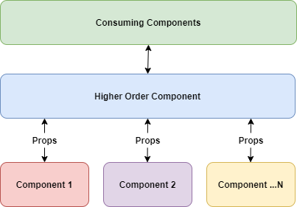

Slide 17
First rule of hooks
Callback and Ref Custom hooks Context
Summary
Ejecting
Unit testing
PWA
Styling React Using CSS
Higher Order Components

